Slide 1
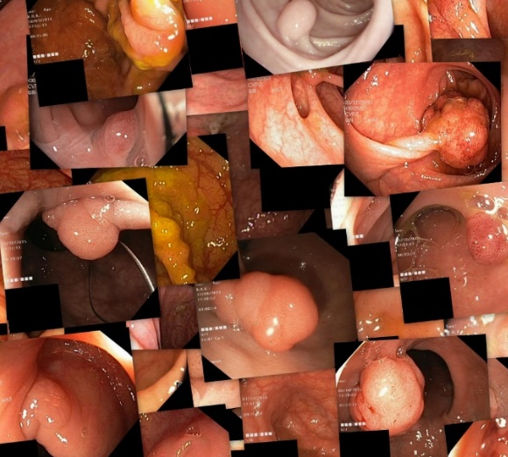
CONV 1
CONV 1
Training Dataset
CONV 2
CONV 2
CONV 3
CONV 3
Validation Dataset
Max Pooling
Transfer
Max Pooling
Fully connected
Fully connected
Testing Dataset
Softmax
Softmax
Output
Output
Performance Analysis

Slide 3

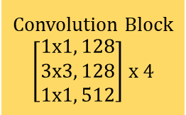
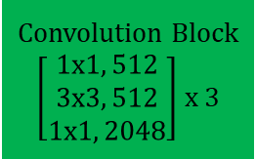
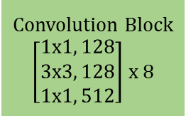
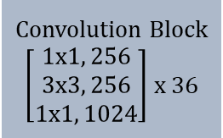
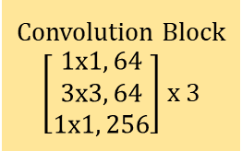

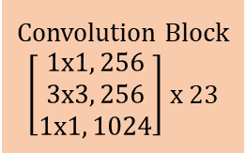

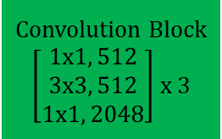

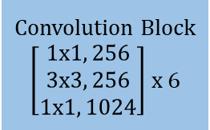

ResNet-50
ResNet-101
ResNet-152
Convolution Block
$\left[\begin{matrix}1x1, 128 \\ 3x3, 128 \\ 1x1, 512\end{matrix}\right]$ x 4
Convolution Block
$\left[\begin{matrix}1x1, 128 \\ 3x3, 128 \\ 1x1, 512\end{matrix}\right]$ x 4
Convolution Block
$\left[\begin{matrix}1x1, 128 \\ 3x3, 128 \\ 1x1, 512\end{matrix}\right]$ x 8
Convolution Block
$\left[\begin{matrix}1x1, 256 \\ 3x3, 256 \\ 1x1, 1024\end{matrix}\right]$ x 6
Convolution Block
$\left[\begin{matrix}1x1, 256 \\ 3x3, 256 \\ 1x1, 1024\end{matrix}\right]$ x 23
Convolution Block
$\left[\begin{matrix}1x1, 256 \\ 3x3, 256 \\ 1x1, 1024\end{matrix}\right]$ x 36
Convolution 7x7, 64
Convolution Block
$\left[\begin{matrix}1x1, 512 \\ 3x3, 512 \\ 1x1, 2048\end{matrix}\right]$ x 3
Convolution Block
$\left[\begin{matrix}1x1, 512 \\ 3x3, 512 \\ 1x1, 2048\end{matrix}\right]$ x 3
Convolution Block
$\left[\begin{matrix}1x1, 512 \\ 3x3, 512 \\ 1x1, 2048\end{matrix}\right]$ x 3
Max Pooling 7x7
Convolution Block
$\left[\begin{matrix}1x1, 64 \\ 3x3, 64 \\ 1x1, 256\end{matrix}\right]$ x 3
Convolution Block
$\left[\begin{matrix}1x1, 64 \\ 3x3, 64 \\ 1x1, 256\end{matrix}\right]$ x 3
Convolution Block
$\left[\begin{matrix}1x1, 64 \\ 3x3, 64 \\ 1x1, 256\end{matrix}\right]$ x 3
Global Average Pooling
Classification - Softmax

Slide 4
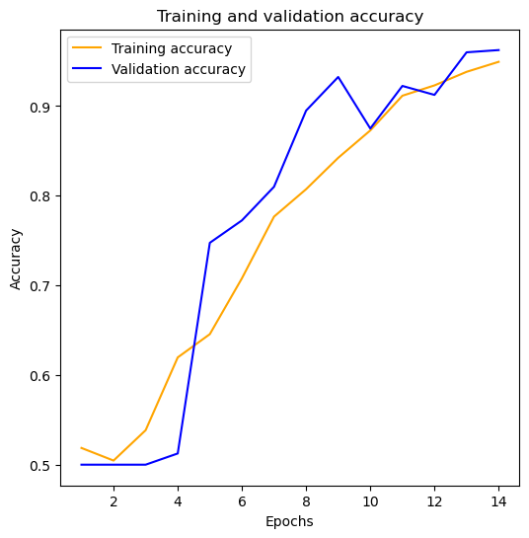
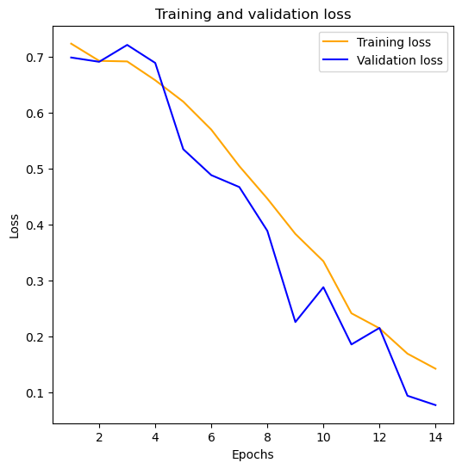
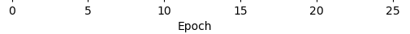
CNN Output

Slide 5
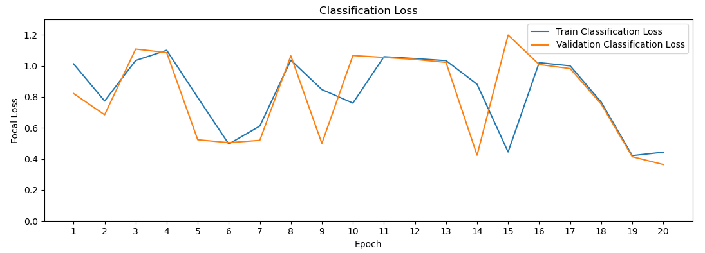
RESNET-101 Training Graph

Slide 6
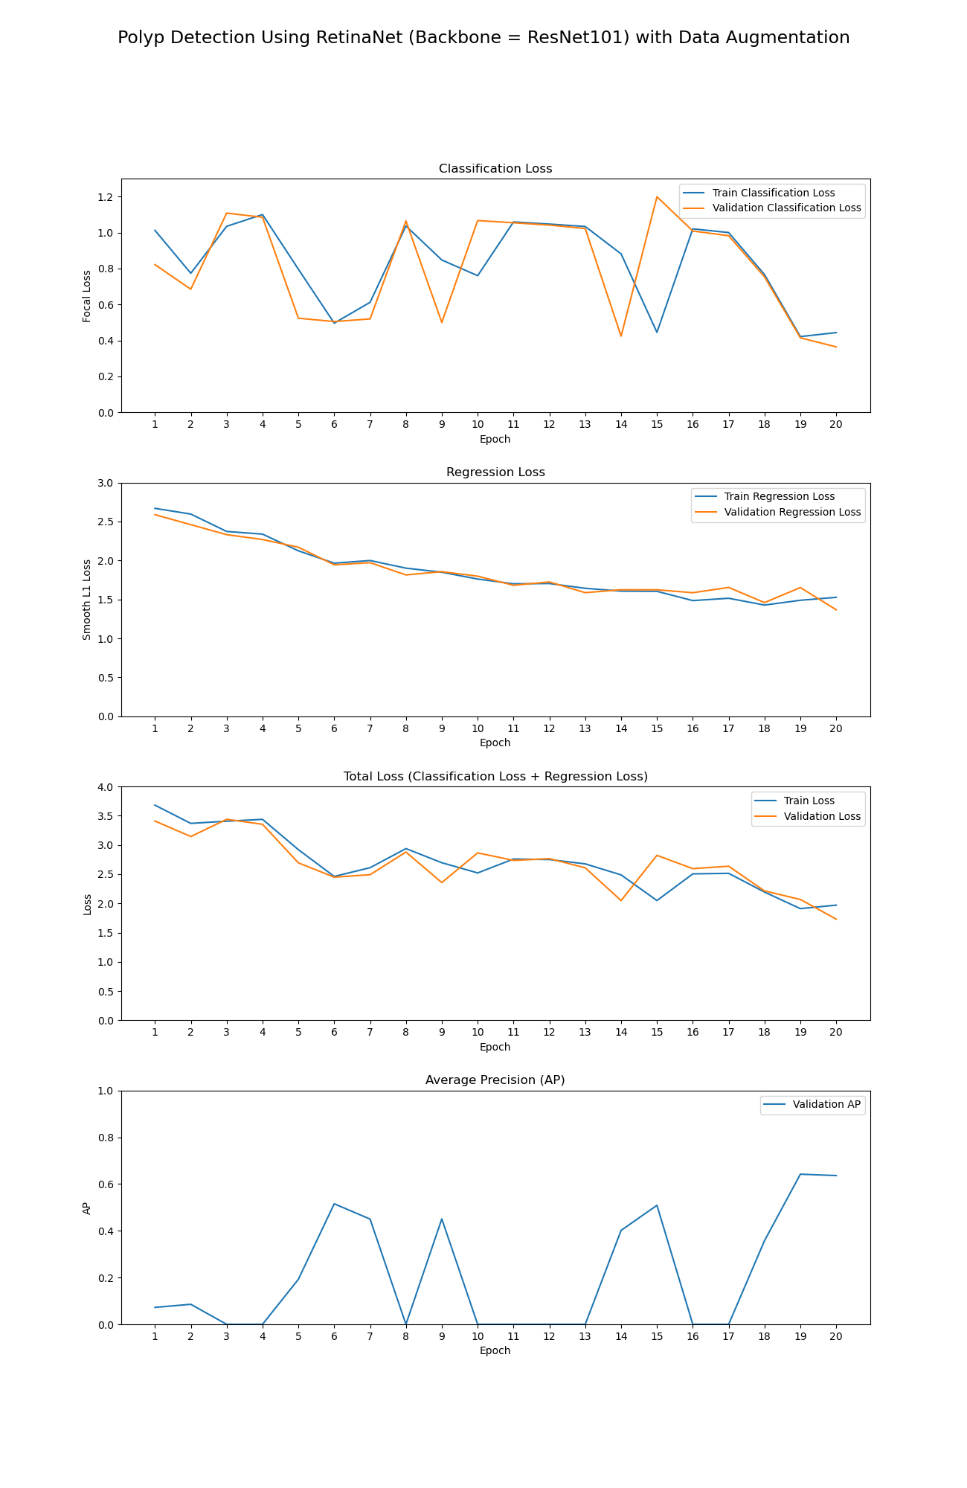
RESNET-101 Training Graph

Slide 7
RESNET-101 Training Graph

Slide 8
RESNET-101 Training Graph

Slide 9
Conclusion
Transfer Learning is Performed Due to the Presence of Less dataset from and less accuracy from the CNN
3 types of Transform Learning techniques is chosen, Resnet-50 accuracy……………., Resnet-101 accuracy…………
In next review I will Compare three transfer learning Techniques and conclude which technique is better
Note : unoda training time 4hrs aachi nu sollu..!! Transfer learning ku.. Athanala dhan late nu

